Slide 1
HR Analytics
P962 | Group 1 |

Slide 2
C ONT E NT S
Introduction
KPI-1 : Average Attrition Rate for all Departments
KPI-2 : Average Hourly Rate of Male Research Scientist
KPI-3 : Attrition Rate vs Monthly Income Status
KPI-4 : Average Working Years for Each Department
KPI-5 : Job Role vs Work Life Balance
KPI-6 : Attrition Rate vs Years Since Last Promotion
Dashboards : Excel, Power BI & Tableau + SQL Queries

Slide 3
INTRODUCTION
HR Analytics is the practice of using data-driven insights to improve workforce planning, employee engagement, and overall organizational performance. In this project, we analyzed employee demographic details, job satisfaction levels, compensation data, and performance metrics to identify patterns and trends that can help reduce attrition, enhance work-life balance, and optimize talent management. By applying analytical tools such as Excel, SQL, Power BI, and Tableau, we transformed raw HR data into meaningful KPIs and visualizations that support strategic decision-making.

Slide 4
DATA S E T
Data Set | HR_1 | HR_2
No. of Rows | 50k | 50k
No. of Columns | 18 | 18
File Format | .xlsx | .xlsx
Dataset type | Excel Data | Excel Data

Slide 5
Tools Used In the Project
Excel
MySQL
Tableau
Power-BI
Data Exploration
Retrieving
Relevant Data according to KPIs
Joining multiple Files
Visualization
Data Exploration
Data Cleaning
Visualization
Joining multiple Files
Data Exploration
Data Cleaning in Power Query
Visualization

Slide 6





DATA A N A LY S IS P RO C E S S
Step 1
Define the Question
Step 2
Collect the data
Step 3
Clean the data
Step 4
Analyze the data
Step 5
Visualize and Share the Insights

Slide 7
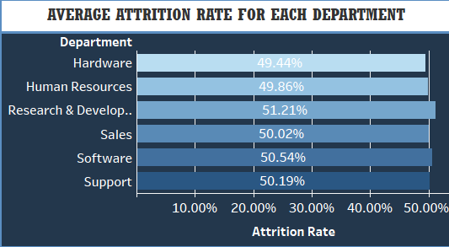
KPI-1 : AVERAGE ATTRITION RATE FOR EACH DEPARTMENTS
This KPI measures the percentage of employees leaving the organization in each department. By analyzing attrition rates across departments, we can identify which areas experience higher employee turnover. Our findings show that certain departments have significantly higher attrition rates compared to others, indicating potential issues such as job stress, lack of growth opportunities, or dissatisfaction with work conditions. Tracking this KPI helps HR teams design targeted retention strategies, improve employee engagement, and reduce hiring and training costs associated with high turnover.

Slide 8
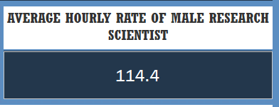
KPI-2 : AVERAGE HOURLY RATE OF MALE RESEARCH SCIENTIST
A4
$35.30 M
This KPI focuses on the compensation of male employees working as Research Scientists. It is calculated by taking the average hourly rate for this specific group from the HR dataset. The purpose of this KPI is to assess pay levels for a targeted job role and demographic, enabling HR to monitor fairness, market competitiveness, and potential pay gaps. By isolating this group, we can compare their compensation with other roles, genders, or industry benchmarks, ensuring that the organization maintains equitable and competitive pay practices.
A3
$19.54 M
$34.56 M
A2
$14.0 M
A1
B5
$37.86 M
B4
$35.41 M
B
B3
$39.72 M
B2
$26.48 M
B1
$21.84 M
C5
$16.02 M
C4
$16.87 M
C
C3
$20.53 M
C2
$27.32 M
C1
$29.38 M
D5
$13.25 M
D4
$13.74 M
D
D3
$16.79 M
D2
$18.57 M
D1
$12.13 M
E5
$7.67 M
E4
$7.99 M
E
E3
$9.04 M
E2
$10.24 M
E1
$11.13 M
F5
$2.19 M
F4
$2.55 M
F
F3
$3.18 M
F2
$4.53 M
F1
$5.84 M
G5
$.70 M
G4
$1.39 M
G
G3
$.83 M
G2
$1.73 M
G1
$1.81 M

Slide 9
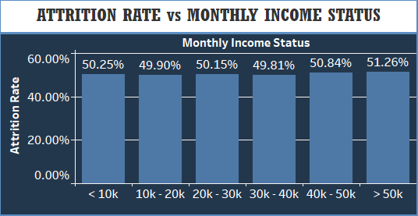
KPI-3 : ATTRITION RATE vs MONTHLY INCOME STATUS
This KPI examines the relationship between an employee’s monthly income and their likelihood of leaving the organization. It helps identify whether salary levels influence attrition trends. Analysis shows that attrition rates tend to be higher among employees in lower income brackets, suggesting that compensation could be a significant factor in retention. In contrast, employees with higher monthly incomes generally show lower attrition rates, possibly due to increased job satisfaction, better benefits, and stronger engagement. By monitoring this KPI, HR can make informed decisions on salary adjustments, benefits enhancement, and targeted retention programs for at-risk income groups.

Slide 10
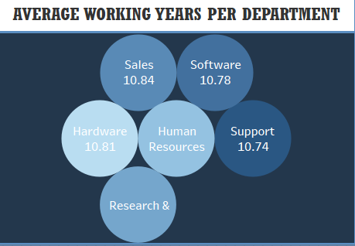
KPI-4 : AVERAGE WORKING YEARS FOR EACH DEPARTMENT
This KPI measures the average number of years employees have spent working in each department. It provides insights into employee retention, departmental stability, and experience levels across the organization. Departments with higher average working years often indicate strong employee loyalty, better job satisfaction, and a positive work culture. On the other hand, departments with lower averages may experience frequent turnover, skill gaps, or challenges in employee engagement. Tracking this KPI helps HR identify which departments excel in retaining talent and which require focused strategies to improve retention and employee development.
$

Slide 11
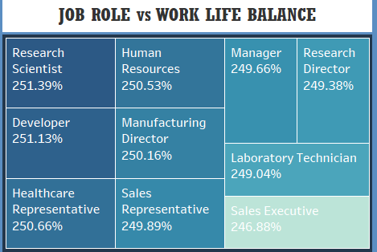
KPI-5 : JOB ROLE vs WORK LIFE BALANCE
This KPI compares different job roles within the organization to evaluate how employees rate their work-life balance. It highlights variations in employee satisfaction regarding the balance between professional responsibilities and personal life. The analysis can reveal that some roles, especially those with high workload or irregular hours, may have lower work-life balance scores. Conversely, roles with more flexible schedules or balanced workloads tend to score higher. Monitoring this KPI helps HR pinpoint roles where work-life balance needs improvement, enabling targeted interventions such as flexible working arrangements, workload redistribution, or wellness programs.

Slide 12
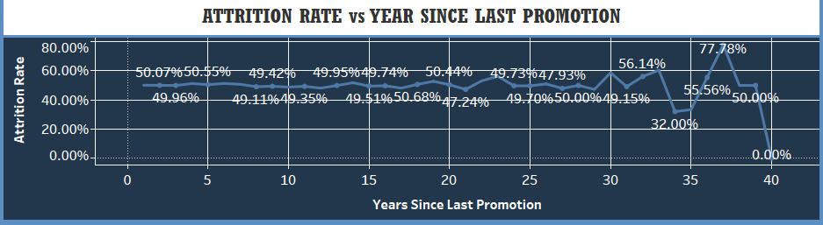
KPI-6 : ATTRITION RATE vs YEAR SINCE LAST PROMOTION
This KPI analyzes the correlation between the number of years since an employee’s last promotion and their likelihood of leaving the organization. Findings often show that employees who have gone several years without promotion tend to have higher attrition rates, possibly due to career stagnation, lack of recognition, or reduced motivation. In contrast, employees who have been promoted more recently usually demonstrate stronger engagement and loyalty. Tracking this KPI helps HR identify employees at higher risk of leaving and implement timely career development plans, training programs, or promotion opportunities to improve retention.

Slide 13
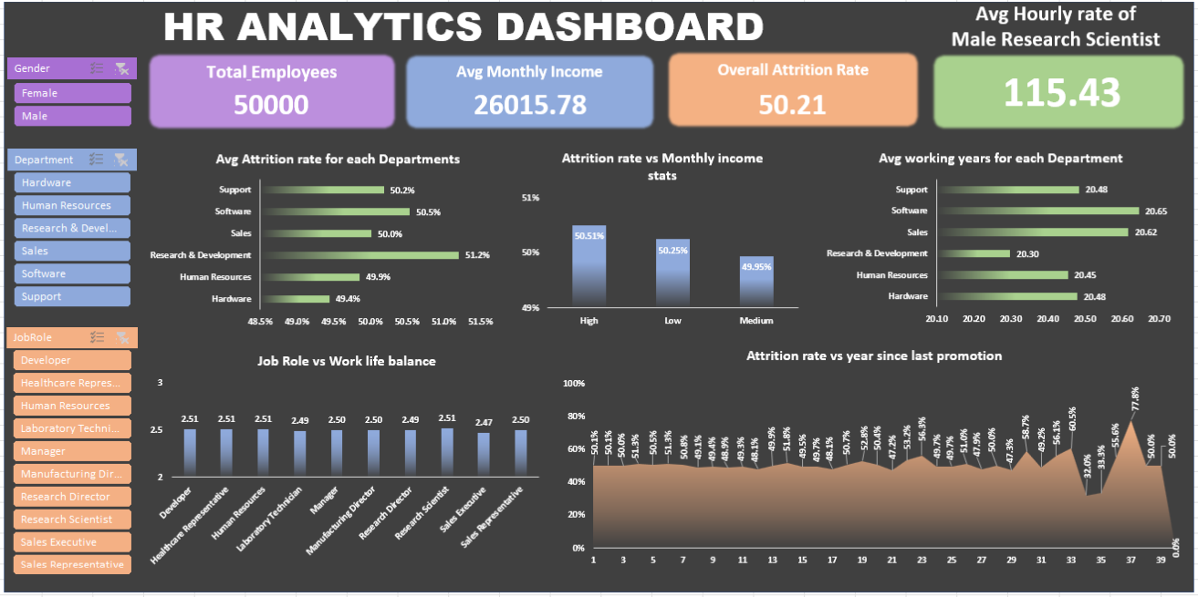
E XCE L DAS H B OAR D

Slide 14
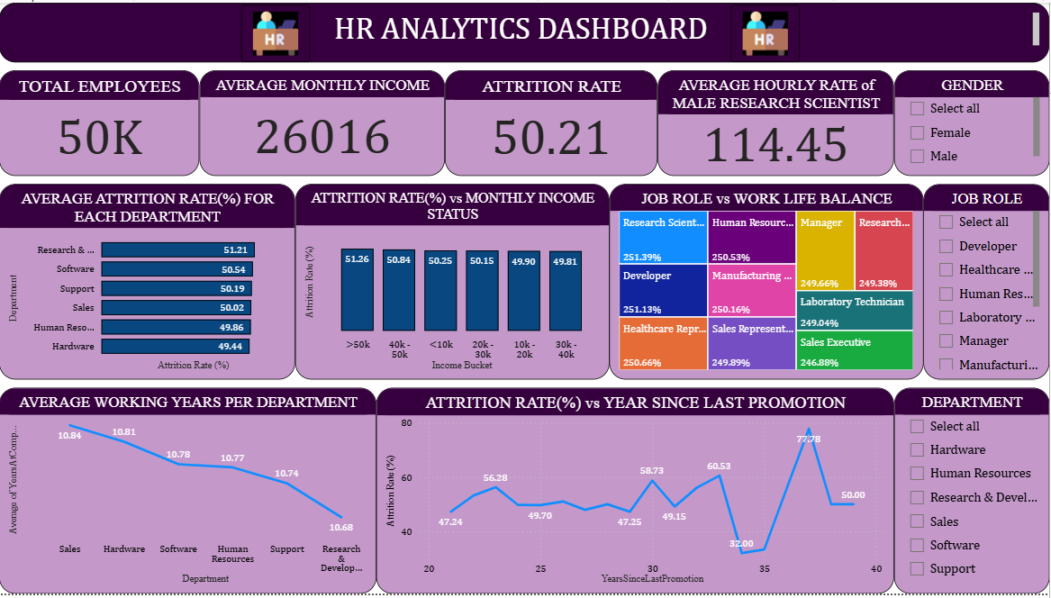
P OW E R B I DAS H B OAR D

Slide 15
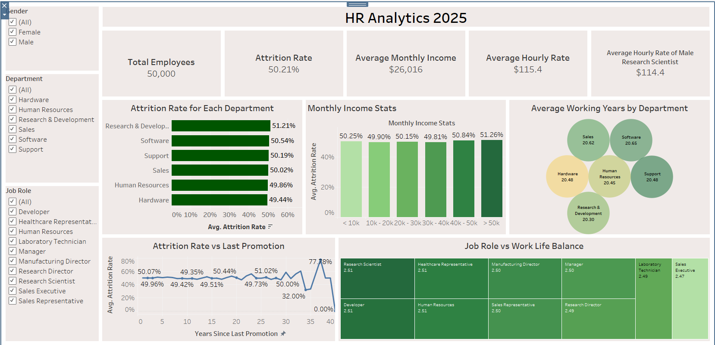
TAB L E AU DAS H B OAR D

Slide 16
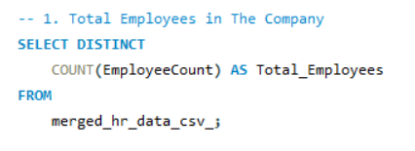
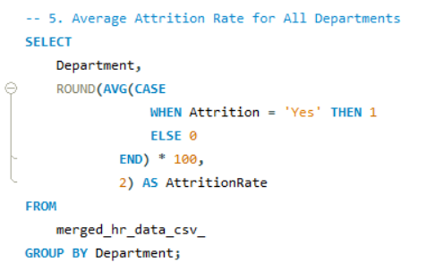
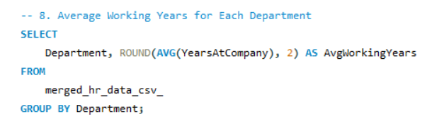
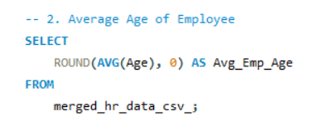
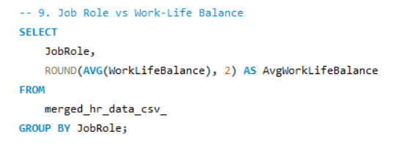
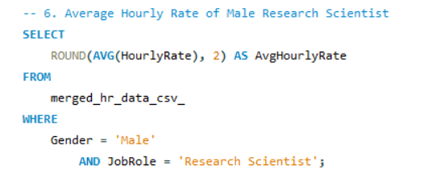
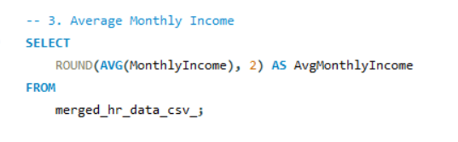
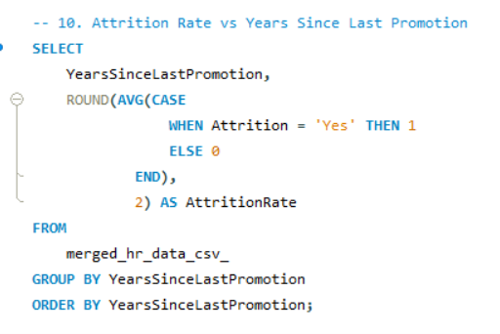
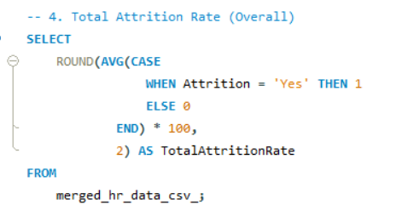
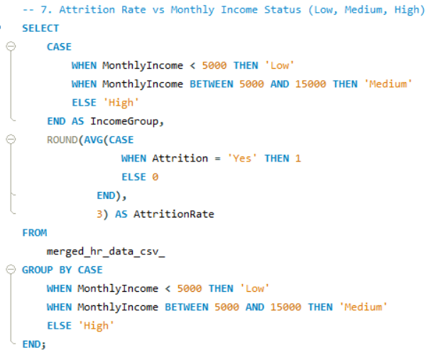
SQL

Slide 17
CONCLUSION
This HR Analytics project reveals that attrition is shaped by factors such as salary levels, overtime, career growth, and work-life balance. By acting on these insights—through fair pay, timely promotions, and employee well-being initiatives—the organization can improve retention, boost engagement, and build a stronger, more stable workforce.

Slide 18
FINAL RECOMMENDATIONS
Reduce Attrition in High-Turnover Departments: Conduct exit interviews, improve team culture, and offer career growth plans.
Address Low Salary-Related Attrition: Adjust pay scales, add performance bonuses, and ensure transparent salary policies.
Improve Work-Life Balance: Offer flexible work options, monitor overtime, and launch wellness initiatives.
Increase Average Tenure: Enhance onboarding, provide department-specific training, and recognize loyalty.
Boost Career Growth: Implement regular promotion cycles, provide skill development programs, and create clear advancement paths.

Slide 19
TH ANK YO U
-SIVA BALAJI BUDUMURI
-PASALS HARSHITA
-ANUSHA NS
-SAKSHI RAJESH LAHOTI
-ARPITA RAGHOBA DEVKAR
-MARIAM KHAN
-MAHAMMAD HARSHAD

